Slide 1
Logistic regression (called Logit Regression)
Logistic Regression is a supervised machine learning algorithm used for classification problems, especially binary classification.
It predicts the probability that an input belongs to a particular class.
If the estimated probability is greater than 50%, then the model predicts that the instance belongs to that class (called the positive class, labeled “1”), and otherwise it predicts that it does not (i.e., it belongs to the negative class, labeled “0”). This makes it a binary classifier.

Slide 2
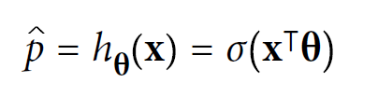
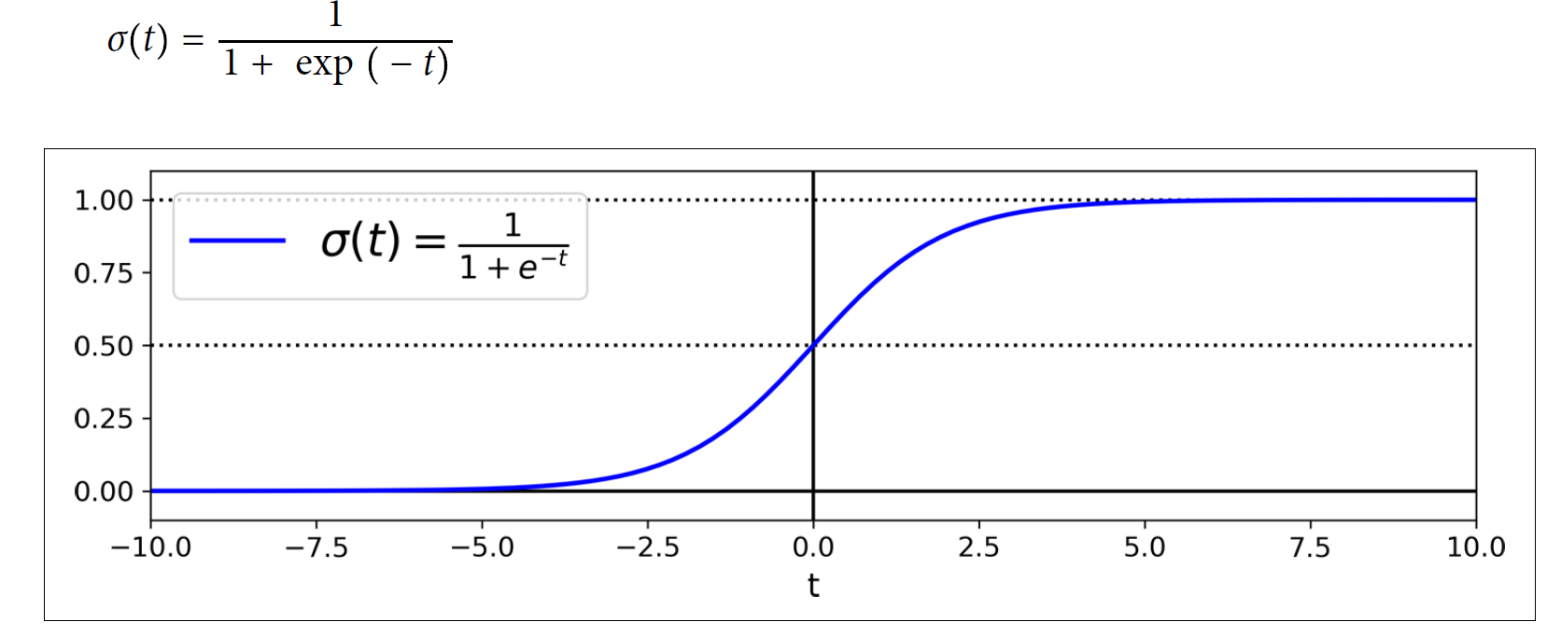
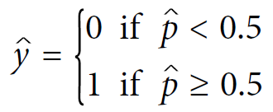
Logistic Regression model estimated probability (vectorized form)
Logistic function
Logistic Regression model prediction

Slide 3
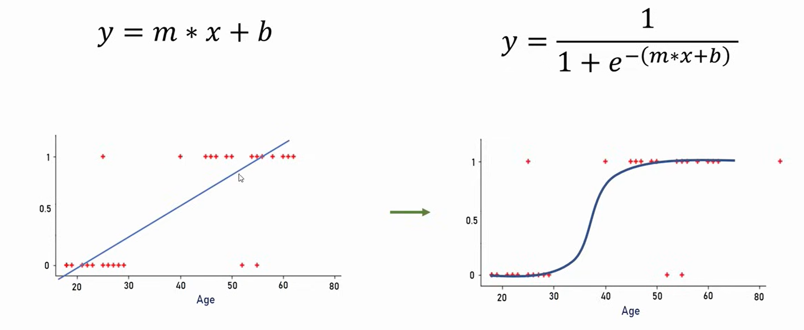
Linear Regression Logistic regression

Slide 4
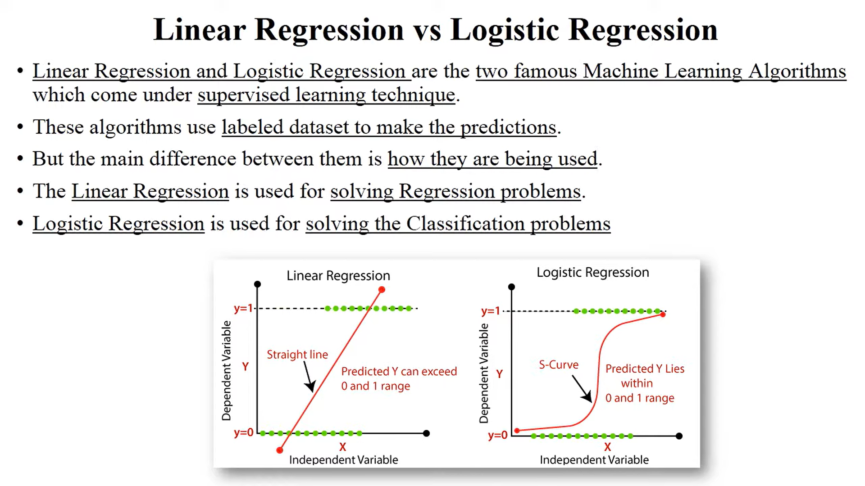

Slide 5
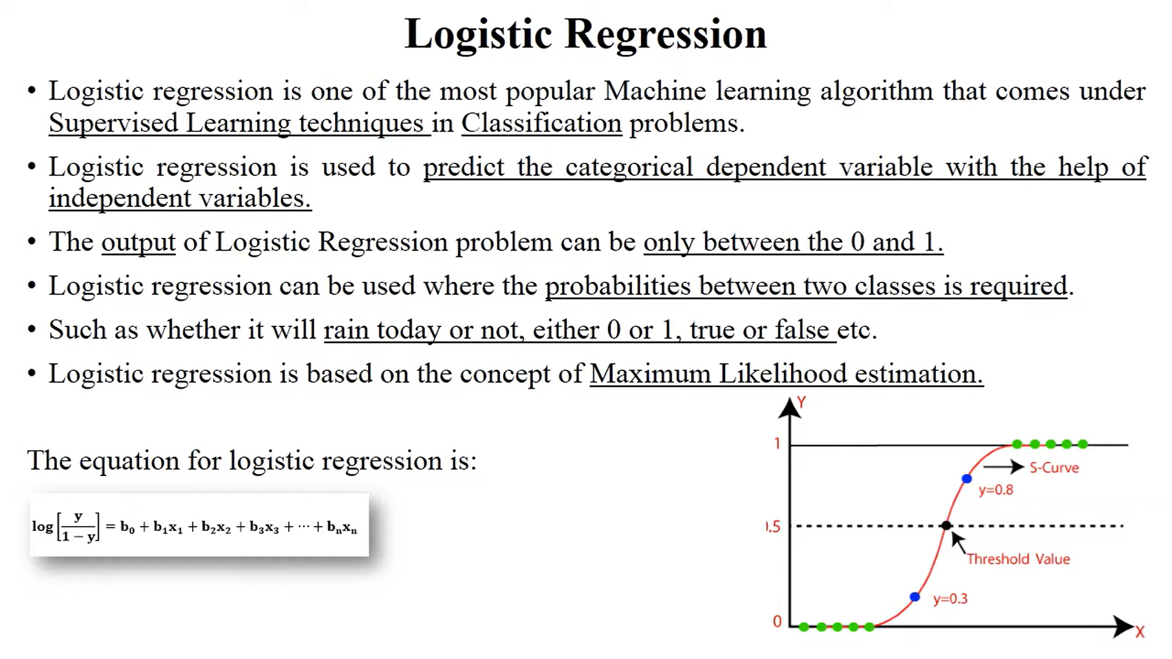

Slide 6
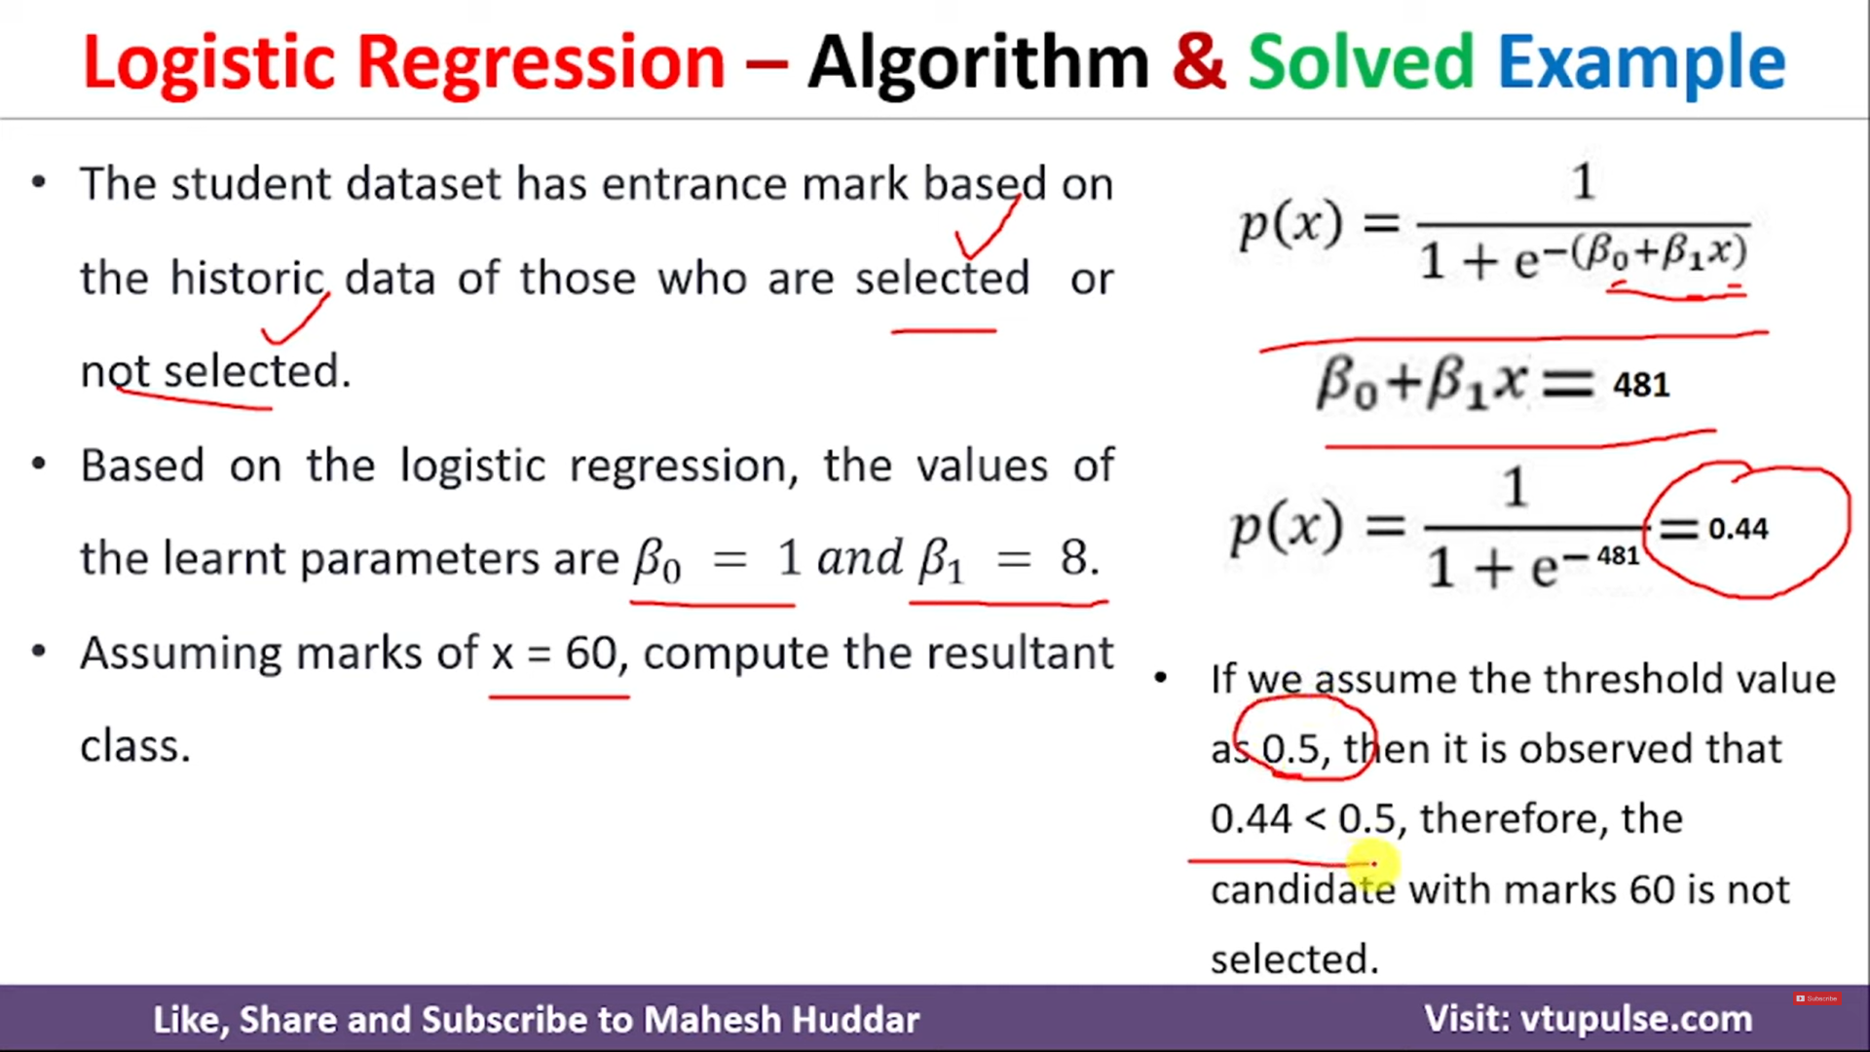

Slide 7
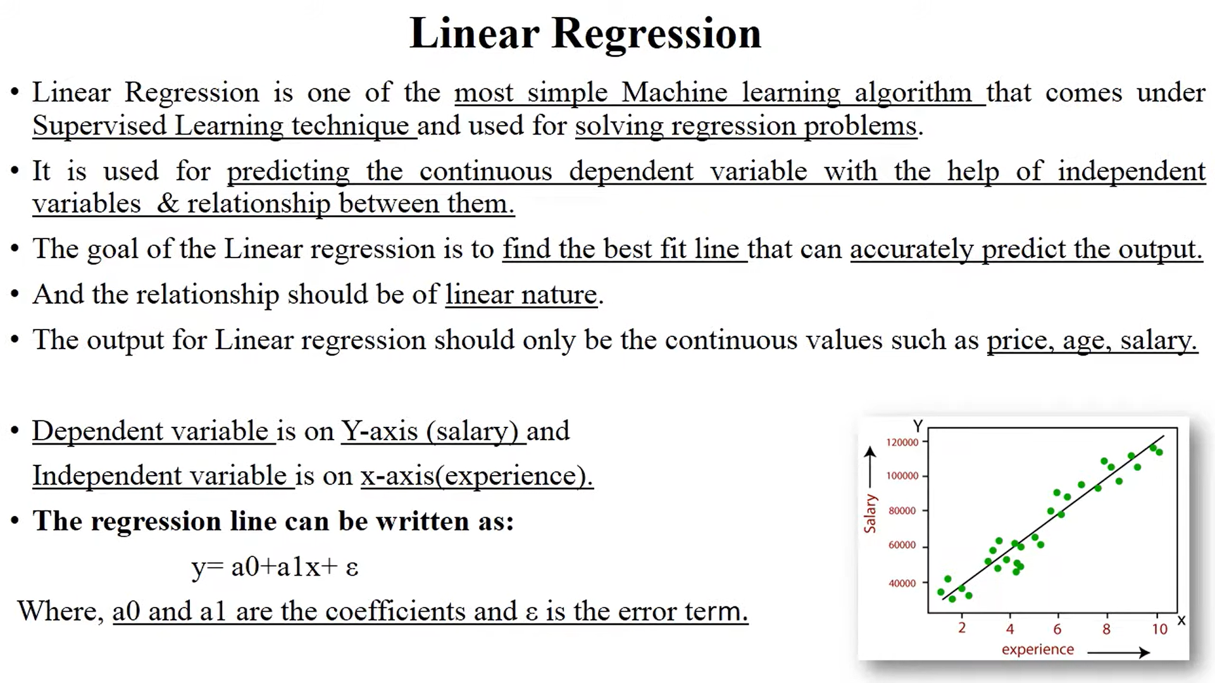

Slide 8
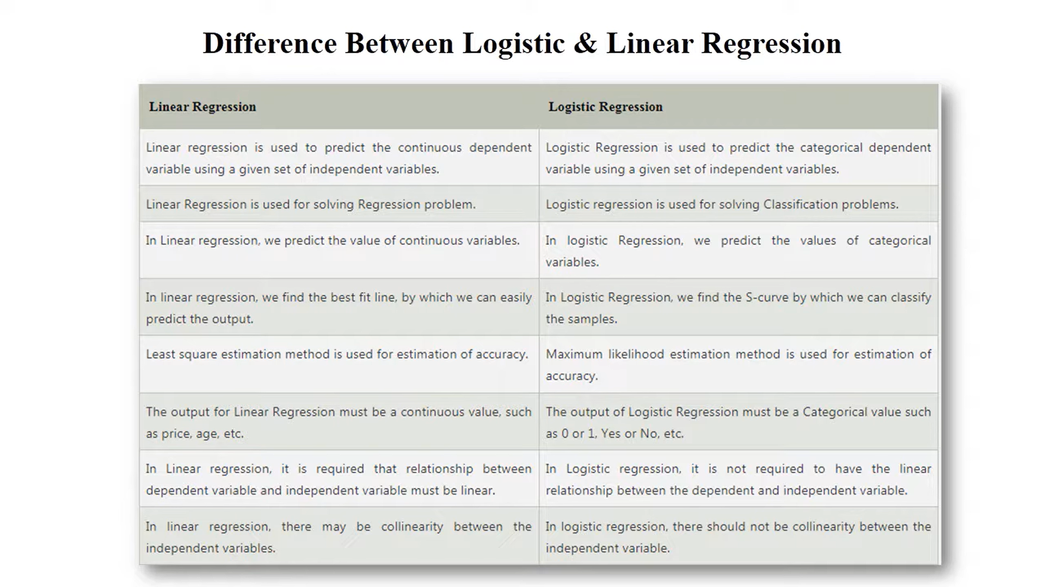

Slide 9
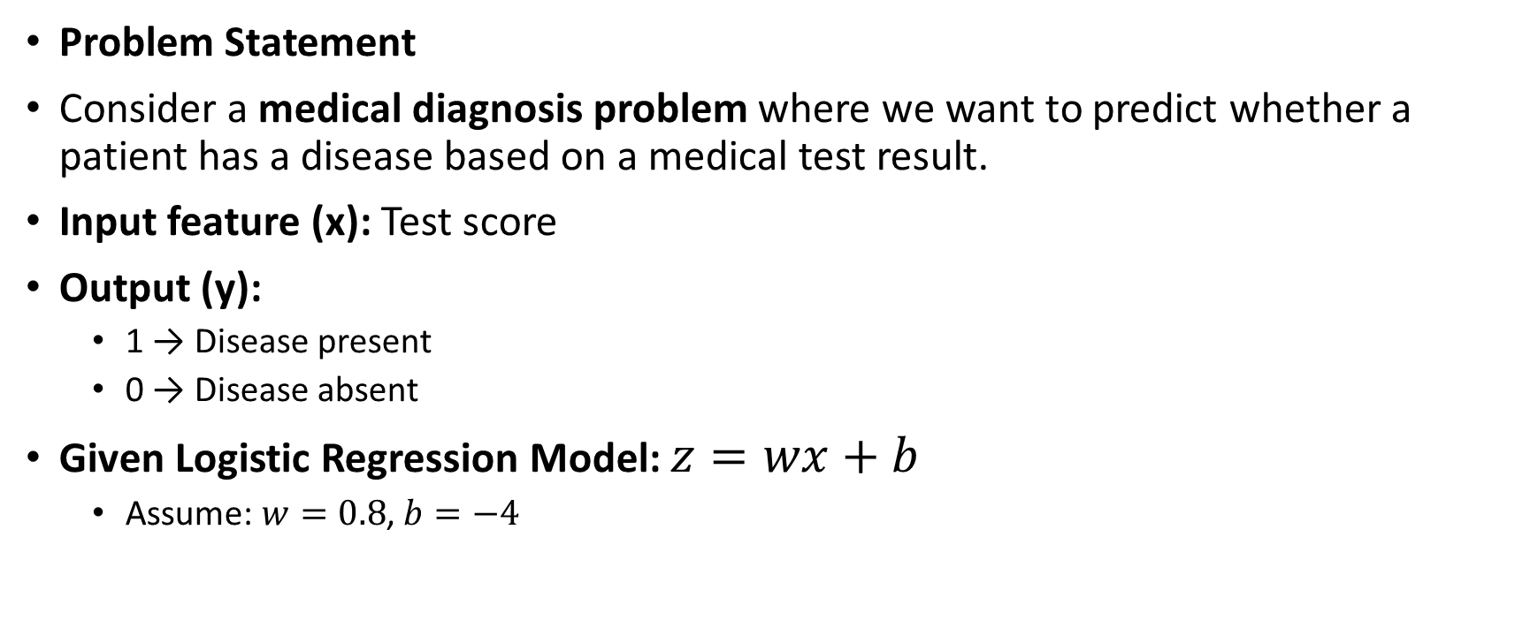
Example of Logistic Regression
Problem Statement
Consider a medical diagnosis problem where we want to predict whether a patient has a disease based on a medical test result.
Input feature (x): Test score
Output (y):
1 → Disease present
0 → Disease absent
Given Logistic Regression Model: $z=wx+b$
Assume: $w=0.8$, $b=−4$

Slide 10
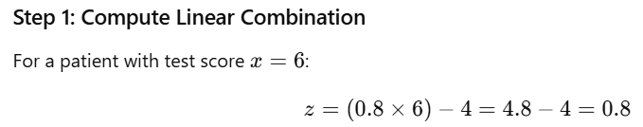
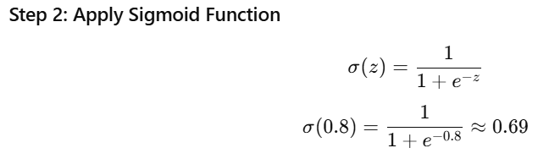
Example of Logistic Regression

Slide 11
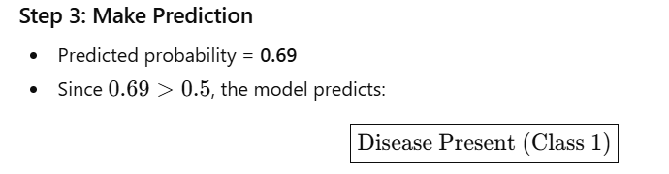
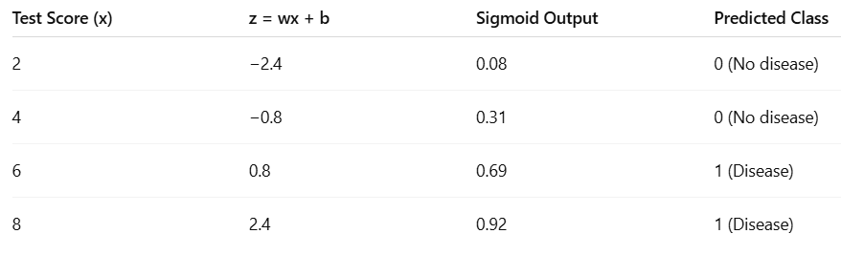
Example of Logistic Regression

